Slide 1
Activity Diagrams

Slide 2
Activity Diagram
Activity diagrams describe the workflow behavior of a system.
  Activity diagrams are used in process modeling and analysis of during requirements engineering.
  A typical business process which synchronizes several external incoming events can be represented by activity diagrams.
They are most useful for understanding work flow analysis of synchronous behaviors across a process.

Slide 3
Activity Diagram
Activity diagrams are used for
  documenting existing process
  analyzing new Process Concepts
  finding reengineering opportunities.
The diagrams describe the state of activities by showing the sequence of activities performed.
  they can show activities that are conditional or parallel.

Slide 4
Activity Diagram Concepts
An activity is trigged by one or more events and activity may result in one or more events that may trigger other activity or processes.
Events start from start symbol and end with finish marker having activities in between connected by events.
The activity diagram represents the decisions, iterations and parallel/random behavior of the processing.
  They capture actions performed.
  They stress on work performed in operations (methods).

Slide 5
Components
An activity is an ongoing, though interruptible, execution of a step in a workflow (such as an operation or transaction)
  Represented with a rounded rectangle.
  Text in the activity box should represent an activity (verb phrase in present tense).
An event is triggered by an activity. It specifies a significant occurrence that has a location in time and space.
  An instance of an event (trigger) results in the flow from one activity to another.
  These are represented by directed straight lines emerging from triggering activity and ending at activity to be triggered. Label text for events should represent event but not the data involved.

Slide 6
Components
A decision may be shown by labeling multiple output transitions of an activity with different guard conditions.
  For convenience a stereotype is provided for a decision: the traditional diamond shape, with one or more incoming arrows and with two or more outgoing arrows, each labeled by a distinct guard condition with no event trigger.

Slide 7
How to Draw an Activity Diagram
Diagrams are read from top to bottom and have branches and forks to describe conditions and parallel activities.
  A fork is used when multiple activities are occurring at the same time.
  A branch describes what activities will take place based on a set of conditions.
  All branches at some point are followed by a merge to indicate the end of the conditional behavior started by that branch.
  After the merge all of the parallel activities must be combined by a join before transitioning into the final activity state.

Slide 8
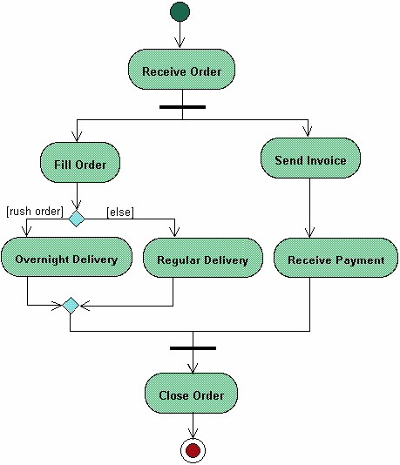
Activity Diagram Example
Start State
Activity
Fork
Branch
Merge
Join
End State

Slide 9
Use Case
Withdraw money from a bank account through an ATM

Slide 10


Slide 11
Disadvantages
A disadvantage of activity diagrams is that they do not explicitly present which objects execute which activities, and the way that the messaging works between them.
  Labeling of each activity with the responsible object can be done.
  It is useful to draw an activity diagram early in the modeling of a process, to help understand the overall process.
Then interaction diagrams can be used to help you allocate activities to classes.

